Slide 1


Environment setup

Slide 2
Setup
Desktop Installation
https://pumas.ai/our-products/pumas/windows
https://pumas.ai/our-products/pumas/mac

Slide 3
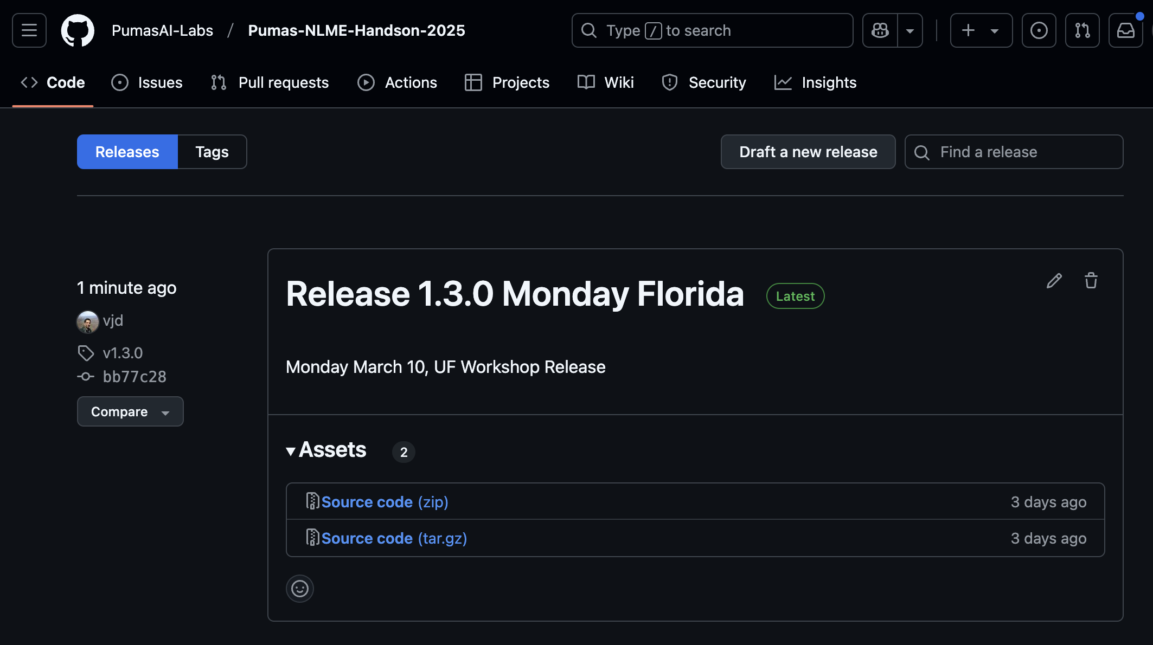
Download the Workshop Material
Download https://github.com/PumasAI-Labs/Pumas-NLME-Handson-2025/releases as a zip file
Go to the terminal and type `unzip Pumas-NLME-Handson-2025-1.3.0.zip`

Slide 4

Accelerating Access to Life-Saving
Treatments to Patients

Slide 5
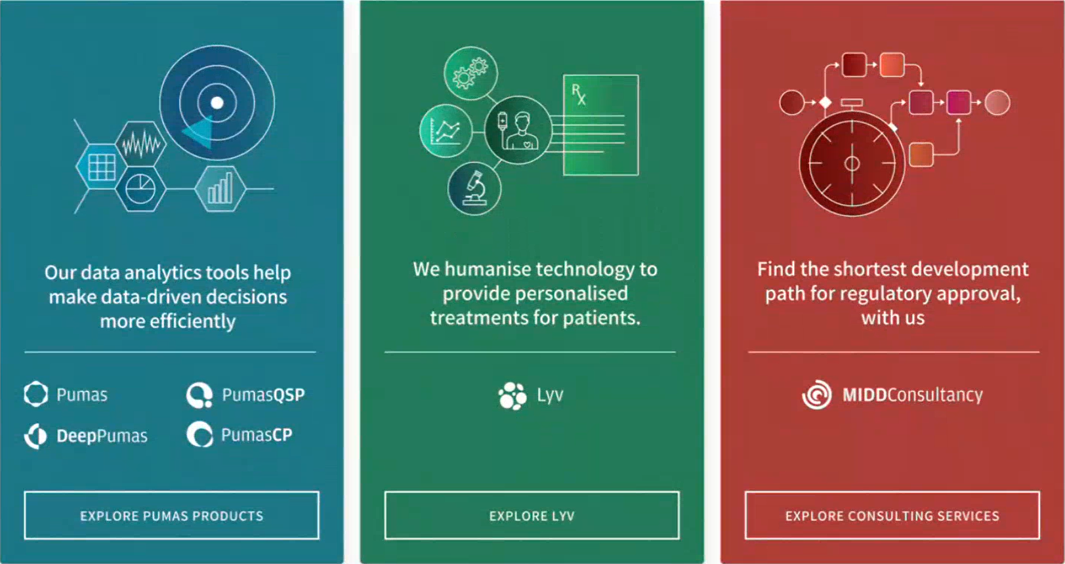

Augmenting healthcare intelligence with predictive analytics that turn data into life-saving decisions
Our data-analytical tools help make data-driven decisions more efficiently
Find the shortest development path for regulatory approval, with us
PumasCP
DeepPumas
Scientific &
Strategic Consulting
Pumas

Slide 6

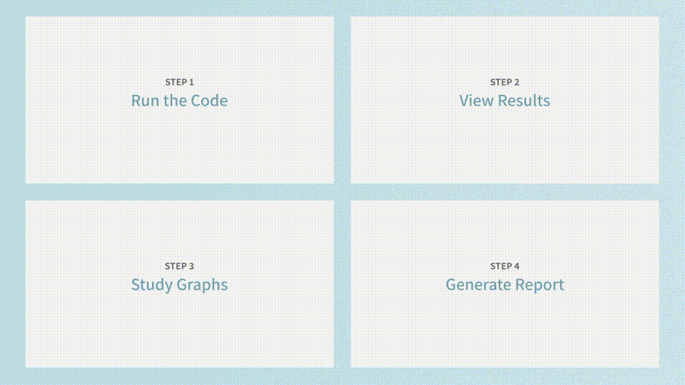

Pumas is a platform for all modeling and simulation needs
Built with
All aspects of an analysis can be performed in the one platform
Reading in data
Data manipulation, visualization, and summarization
Statistical analysis (non-linear and linear mixed effect modeling, non-compartmental analysis, etc)
Performing model simulations (stochastic simulations, clinical trial simulations, etc)
Performing model applications (optimal design, Bayesian forecasting, etc)
Plotting (generation of goodness-of-fit diagnostics, visual predictive checks, presentation of simulation output)
Reporting (through Quarto)

Slide 7
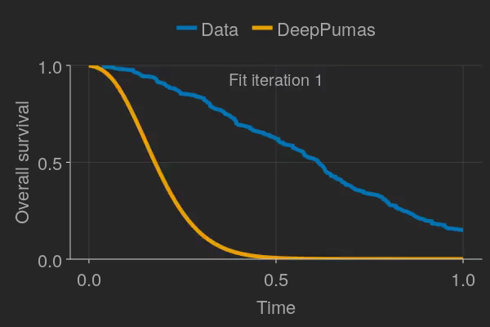


Hands on NLME Workshop in Pumas – 2025
University of Florida 10-12 March 2025

Slide 8
Workshop Objectives
Provide an introduction to the Julia programming language and highlight its importance in a NLME workflow with Pumas
Introduce Pumas for NLME with examples of population PK and population PK/PD models
Demonstrate additional utilities of Pumas with respect to model diagnostics
Provide examples of simulating from models in Pumas
Introduce reproducible reporting in the Pumas platform

Slide 9
Additional Pumas Training Resources
Pumas Tutorials
Pumas Documentation
PumasAI YouTube Channel
Pumas Discourse (Online Discussion Forum)

Slide 10
Additional Julia Training Resources
Julia documentation
Julia packages for:
Reading in Data:
CSV.jl, ReadStatTables.jl
Data Wrangling and Manipulation:
DataFrames.jl, DataFramesMeta.jl, Impute.jl
Data Visualization:
AlgebraOfGraphics.jl, CairoMakie.jl

Slide 11
Other Information
Events: https://pumas.ai/events
Resources: https://pumas.ai/resources
Sales contact: sales@pumas.ai
Consulting contact: consulting@pumas.ai

Slide 12
wrap-up

Slide 13
Workshop Feedback - Survey
Webinar/Workshop Survey- Pumas

